Slide 1


City of Baltimore
Fiscal 2017 Ordinance of Estimates
Department of Finance| May 31, 2016
Notes:
I am going to give you a more focused, summary level presentation of the budget than in previous years.
I will present 26 slides and have included an additional 30 appendix slides in the deck in front of you. I will happy to answer questions about those slides also.
Questions about specific items in agency budgets are best discussed in the agency budget hearings that will follow my presentation.

Slide 2
FY17 by the Numbers
FISCAL 2017 | Recommended Amount | Change from Fiscal 2016 | Percent Change from Fiscal 2016
OPERATING PLAN | $2.646 billion | +$92.2 million | +3.6%
CAPITAL PLAN | $524 million | -$148.9 million | -22%
TOTAL PLAN | $3.2 billion | -$56.7 million | -1.8%
FISCAL 2017 General Fund | Recommended Amount | Change from Fiscal 2016 | Percent Change from Fiscal 2016
BUDGET | $1.763 billion | +$41.9 million | +2.4%
POSITIONS | 9,392 | -181 | -1.9%
Notes:
WWW utilities - $12M new rate and rate structure going to BOE next week
Conduit - $8M
Federal - $17M Maternal and Child Health ($4M), HIV Treatment ($4.5M), Permanent Housing for the Homeless ($2.5M), SAFER Grant ($2.6M)
Special - $9M EMS ($4M), Circulator ($6M)
State demolition funding of $18.5M not reflected, as it will flow through Maryland Stadium Authority
$1.5M from State Rainy Day earmarked for health care coordination and Safe Streets, subject to Governor’s approval
Much of the funding package for Baltimore approved by the General Assembly – for libraries, after-school programs and parks – becomes available starting in Fiscal 2018.
-$216M for water utility revenue bonds – multi-year funding for infrastructure projects
+$30M for Conduit from rate increase
+144M State grants, including $130M for wastewater projects from Bay Restoration Fund and $23.2M for central library renovations
Position changes:
Police vacancies -225
CACs -8
Before/After -5
Crime Lab +16
DHR Civil Service +9
CRB +4
SAO +10 (body cams)
Police +5 (body cams)

Slide 3

FY17 Budget Highlights
Closes $60 million shortfall
Enhances school funding
Continues property tax rate reduction
Makes Circulator finances sustainable
Funds citywide Municipal Can program
Equips police with body cameras
Continues progress on Ten-Year Financial Plan
Maintains or enhances most services
Tough but sensible tradeoffs

Slide 4
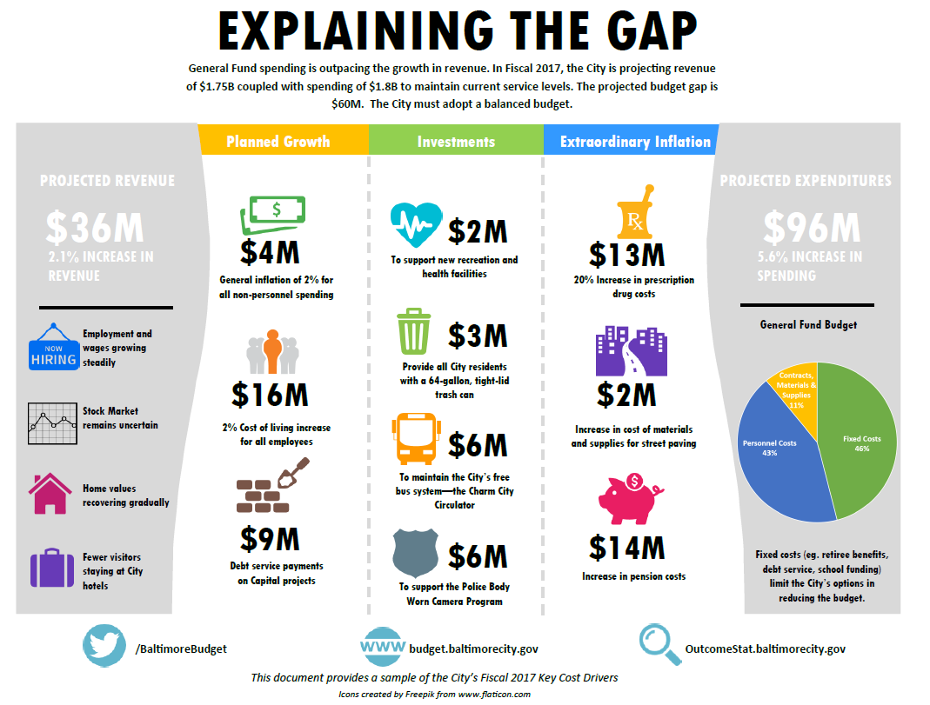
CLS Cost Drivers
Infographic
Notes:
Revenue growth of 2.1% is not bad. It is in line with general inflation in the economy, but not nearly enough to keep up with the City’s cost growth. I will talk first about the revenue side.
Current revenue:
Fiscal 2016 budget = $1.707B
Fiscal 2016 projection = $1.75B
Fiscal 2017 recommendation = $1.762B
Projecting a small surplus in Fiscal 2016, mainly due to good results from our most volatile revenues, Income Tax and Transfer and Recordation Taxes. Overall current revenue was 2.4% above the budget estimate, close to our target of 2% accuracy.
Income tax revenue driven by factors that we can’t expect to repeat: 1) reconciliation of Fiscal 2014 returns, 2) capital gains from stock market sell-off in early 2016. Income tax distribution formulas have not yet caught up to economic recovery of Washington, D.C. suburbs. Formula adjustments could mean negative adjustments in next year’s reconciliation.

Slide 5
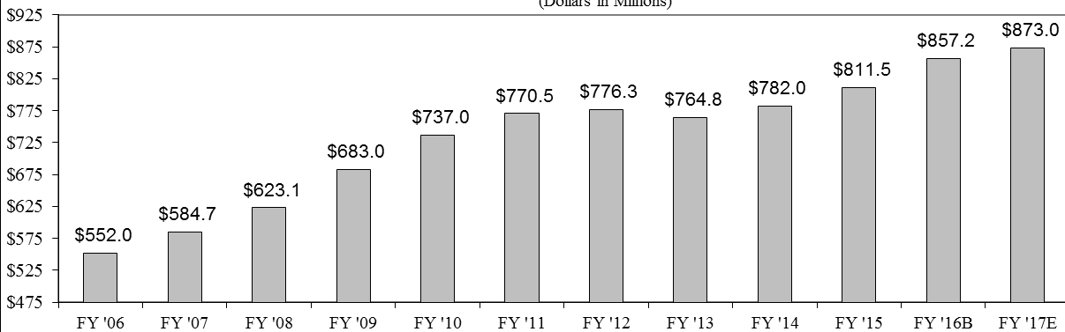
Revenue:
Continued Property Tax Growth Expected
Real and Personal Property Tax Revenues
(Dollars in Millions)
14% growth since Fiscal 2013.

Slide 6
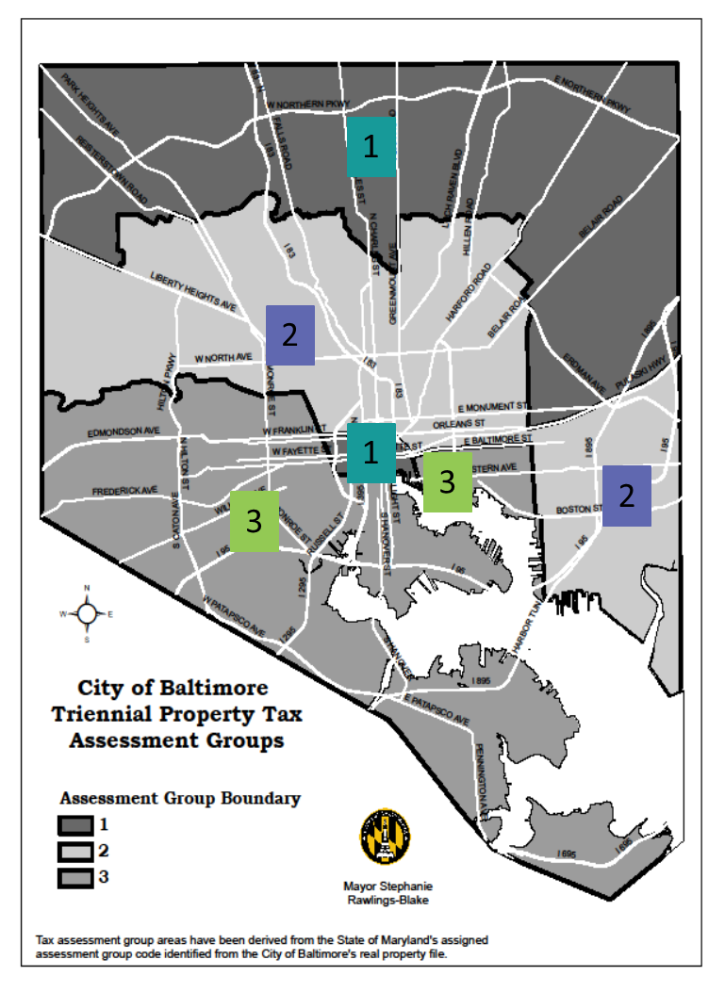
Revenue:
Property Value Growth
3 years of assessment increases after four years of decline.
Notes:
Property and Income Tax growing
Group I assessment growth of 10.9% matches statewide average. 21% commercial, 4.9% residential
Property Tax growth mitigated by 40% of Group I residential properties losing value
Adjusted Transfer and Recordation tax revenue up $7M (to $70M) – we are careful not to rely too heavily on these volatile revenue sources to fund recurring expenses.
Income Tax up $24M (to $318M) from Fiscal 2016 budget
We are also seeing some growth in HUR ($4.5M, to $142M). Still $85M below Fiscal 2007 peak.
Assuming additional revenue from higher interest rates ($2.2M and parking fund transfers ($1.9M).
Estimate includes a one-time additional transfer of $1M for street sweeping from the Stormwater Utility.
State Aid is more or less flat.
No speed camera revenue and no fund balance to offset the missing revenue (-$10M)
Also seeing the impact of reduced Minor Privilege Permit fees (-$0.8M)
The difference between our initial revenue projection and our final budget estimate is $6M from a new voluntary payment agreement with major non-profits.
Full revenue details start on page 31 of the Executive Summary publication.

Slide 7
CLS Cost Drivers
Infographic
Notes:
Discuss pie chart.
After growing less than 4% over the past four fiscal years, fixed costs are up 4.5% in Fiscal 2017.
Details about fixed costs can be found starting on page 5 of the Executive Summary publication.

Slide 8
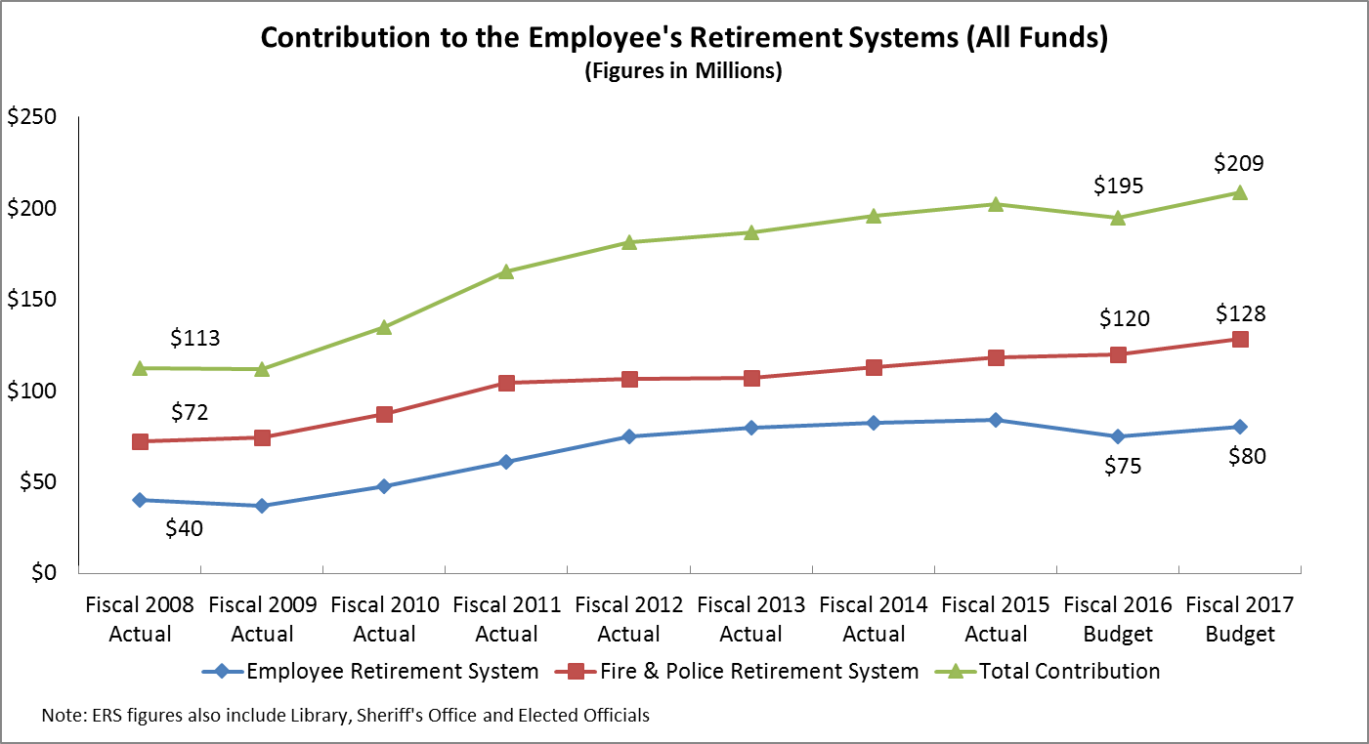
ERS Contribution
Notes:
Four reasons for pension cost growth:
Investment returns of 3.5% in 2015 vs. assumption of 7.75%
Reduction of investment return assumption by both funds to 7.5%
Changing of actuarial methods in recent years that increase costs now but will put funds on a more sustainable path.
Experience study showing that retirees are living longer

Slide 9
Health Care Costs

Slide 10
FY17 Budget Highlights
Closes $60 million shortfall
Enhances school funding
Continues property tax rate reduction
Makes Circulator finances sustainable
Funds citywide Municipal Can program
Equips police with body cameras
Continues progress on Ten-Year Financial Plan
Maintains or enhances most services
Tough but sensible tradeoffs
Notes:
Funding for City Schools is $10.4M above the State mandated level.
The main flash point in this budget is the fact that it does not continue the $4.2 million in one-time additional funding for OST, job training and capacity building. I want to explain the relationship between the $4.2M and the increased funding for City Schools in the Fiscal 2017 budget.
The Fiscal 2016 budget approved by the Council included $10M intended for City Schools as part of a proposed agreement under which City Schools would take responsibility for the retiree health benefit costs of employees it has hired since it separated from city government in 1997. When it became clear that we would not be able to reach agreement with City Schools for Fiscal 2016, we were able to transfer a portion of the $10M for the one-time boost to OST and other programming.
We have continued discussions with City Schools about retiree health, and once again included $10M in the Fiscal 2017 preliminary budget. When the General Assembly learned of this $10M, it wrote into the budget bill a directive that we provide it to City Schools with no strings attached or risk losing the supplemental Income Tax Disparity grant that helps us fund our share of teacher pension costs.
The $10M from the city, combined with a $12.7M commitment from the Governor, largely makes up for reduced State formula aid. The City Schools stood to lose funding due to the removal of 2,000 “ghost students” from the enrollment count and growth in the City’s wealth relative to the rest of the State.
As much as we would like to continue the higher funding level for OST, the Mayor was clear that it was a one-time transfer, and given the combination of having to close a $60M budget shortfall and increase school funding, the best we could do was to maintain the base Family League OST funding of $6.2M.

Slide 11
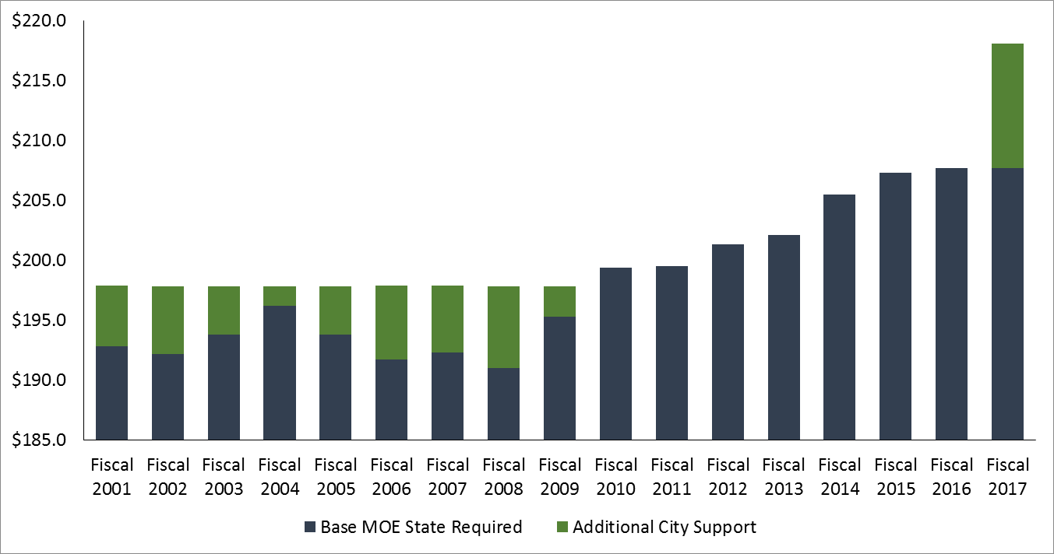
Maintenance of Effort
Maintenance of Effort Support
(in millions)
Notes:
Total MOE in Fiscal 2017 is $265.4 million
Includes $17.9 million for Teacher Pension and $29.8 million for Retiree Health Benefits
In addition to MOE, the City pays $2.7M and $4M for crossing guards.
See page 22 of Agency Detail Volume II
On the capital side, our costs include $19 million for debt service on projects funded in previous years, $17 million in new GO Bond funding, and $23M contributed to the $1.1 billion school modernization program.
This brings total support for City Schools to more than $330M.
This year, the City completed its funding of termination leave payments under a 2001 agreement with the City Schools. That agreement called for 15 annual payments of $2.8M.

Slide 12
Fixed Costs and Public Safety
Fixed Costs and Public Safety comprise 77% of the Fiscal 2017 General Fund Revenues.
Fixed Costs include BCPS Contribution, Retiree Health, and Debt Service.
“Remaining Revenue” is the full amount available to distribute to all other City priority outcomes.
Note: Pension and Worker’s Compensation costs for Public Safety services were moved from Fixed Costs to Public Safety. Pension and Worker’s Compensation for non-Public Safety services were moved from Fixed Costs to Remaining Revenue.
Notes:
This is a perspective on the General Fund budget showing that 77% of revenue goes for public safety and fixed costs, leaving only 23% to fund all other city services.
This budget takes unprecedented steps to control police funding, both to help achieve structural budget balance and redirect available funding to crime prevention, schools and other investments in the city’s future well-being.
Public Safety: Police, Fire, State’s Attorney, Sheriff.
All other: Public Works, Transportation, Health, Recreation and Parks, Housing, General Services, Libraries, Information Technology, Employment Development – everything else.

Slide 13
Police Budget
BPD will move officers from behind desks to patrol, end manual timekeeping, equip officers with field-based reporting technology, and fill remaining vacancies through stepped-up recruitment and retention strategies.
With a smaller force (220 positions were abolished in Fiscal 2016; 225 salary-saved in Fiscal 2017), the department will divert more non-emergency calls to telephone response and better align
staffing with crime patterns.
Fiscal 2016 Adopted | $444,183,791
COLA | $4,478,711
Body Worn Cameras | $6,800,000
Ceasefire Analyst | $76,000
Transfer of 911 Dispatch from MOIT | $7,376,866
Equipment Replacement | $685,717
Technology/ Software Upgrades | $693,000
Pension | $5,916,727
Other Adjustments | $675,100
Fiscal 2017 CLS | $470,885,912
Sworn COLA | ($3,990,282)
Position Salary Savings | ($20,766,859)
Crime Lab Positions | $1,247,814
Worker's Compensation | $3,238,673
Other Adjustments | $856,959
Fiscal 2017 Recommended Budget | $451,472,227
BPD will rely more on the Crime Lab, data analysis, and CitiWatch cameras, all of which have been enhanced.
Notes:
CLS Other Adjustments: pending personnel, MOIT refresh, other fixed costs, inflation
CLS to BOE Other Adjustments: Caroline’s $2M TLS adjustments, $950K legal fees, other fixed costs (retirement/social security)

Slide 14
Union Pay Raise Comparison
Notes:
The proposed budget freezes pay for sworn police, fire and Sheriff employees to help close the shortfall. These employees have received significantly larger pay increases than civilians over the past three fiscal years. Civilians would receive 2% increases in the budget, with 1% for the continued phase-in of employee pension contributions. The 5% contribution will be fully phased-in in Fiscal 2018.

Slide 15
Crime Prevention
The Fiscal 2017 budget invests in non-traditional initiatives including health-based violence prevention, adequate lighting of public spaces, diversion of non-violent offenders from criminal prosecution, re-integration of ex-offenders, and training/human capital development.
These programs support crime prevention in the City and provide a high return on investment in the context of the Safer Streets indicators.
CitiWatch Analytics Enhancement | $150,000
Operation Ceasefire Program | $449,398
Project Safe Streets Local Matching Funds | $200,000
Civilian Review Board Positions | $400,000
Bridge to Career Program | $40,000

Slide 16
FY17 Budget Highlights
Closes $60 million shortfall
Enhances school funding
Continues property tax rate reduction
Makes Circulator finances sustainable
Funds citywide Municipal Can program
Equips police with body cameras
Continues progress on Ten-Year Financial Plan
Maintains or enhances most services
Tough but sensible tradeoffs

Slide 17
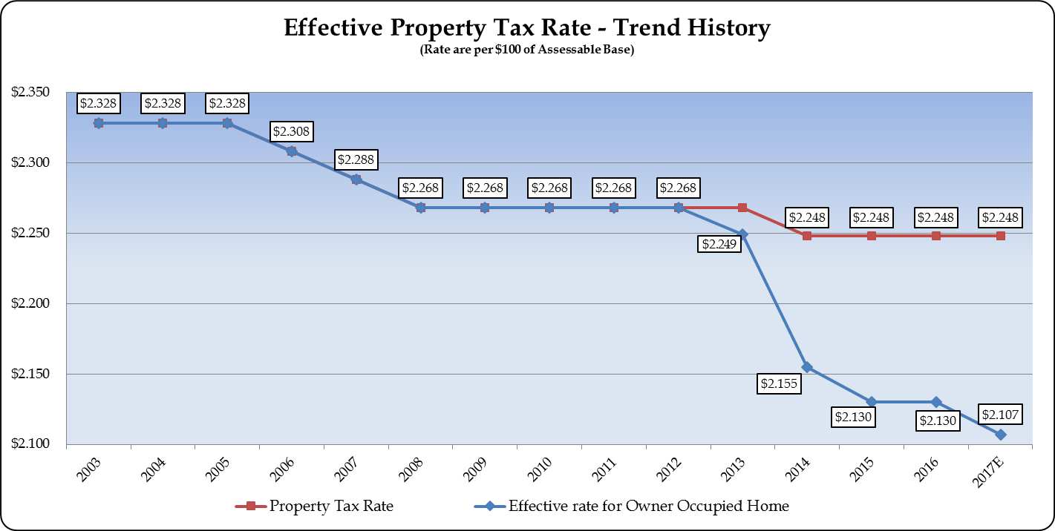
20 Cents by 2020 – On Track
Notes:
Cost of 12.9 cent THTC reduction is $24.3 million.
Casino lease revenue covers $9.9 million. Net GF cost of $14.4 million.
The property tax reductions will save the average homeowner more than $300 a year. The incremental reductions are adding up – the Fiscal 2017 effective rate is 7.1% below the Fiscal 2012 rate (and 9.5% below the Fiscal 2005 rate). Average reduction of $450 per year vs. 2005 rates. When 20 by 2020 is completed, savings will be close to $600 per year.
Other jurisdictions are raising their property tax rates, so while the gap is still large, it is shrinking.
While it is hard to pinpoint the economic impact of the reductions, Baltimore’s property assessment growth has exceeded the statewide average over the past three years. Some have pooh-poohed these tax rate reductions as small change and want to reverse course so that we can increase spending. These are tough choices, but the Administration believes that lower tax rates help to grow the city’s tax base, which will pay big dividends for the City’s economic future.

Slide 18
FY17 Budget Highlights
Closes $60 million shortfall
Enhances school funding
Continues property tax rate reduction
Makes Circulator finances sustainable
Funds citywide Municipal Can program
Equips police with body cameras
Continues progress on Ten-Year Financial Plan
Maintains or enhances most services
Tough but sensible tradeoffs

Slide 19
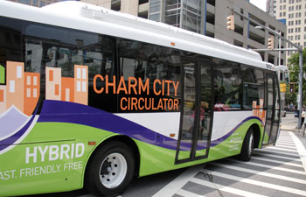
Circulator
The Circulator’s Special Fund was in deficit by about $15 million at the end of Fiscal 2015.
The Fiscal 2017 budget reflects the full long-term cost of the service, including the Purple Route expansion, contributions to a bus replacement fund, deficit reduction, and future cost growth.
To support the full cost of the service, the Administration has proposed raising the parking tax from 20% to 24%. The $6 million raised through the 4% increase will go entirely towards the costs to operate the Circulator.

Slide 20
FY17 Budget Highlights
Closes $60 million shortfall
Enhances school funding
Continues property tax rate reduction
Makes Circulator finances sustainable
Funds citywide Municipal Can program
Equips police with body cameras
Continues progress on Ten-Year Financial Plan
Maintains or enhances most services
Tough but sensible tradeoffs

Slide 21
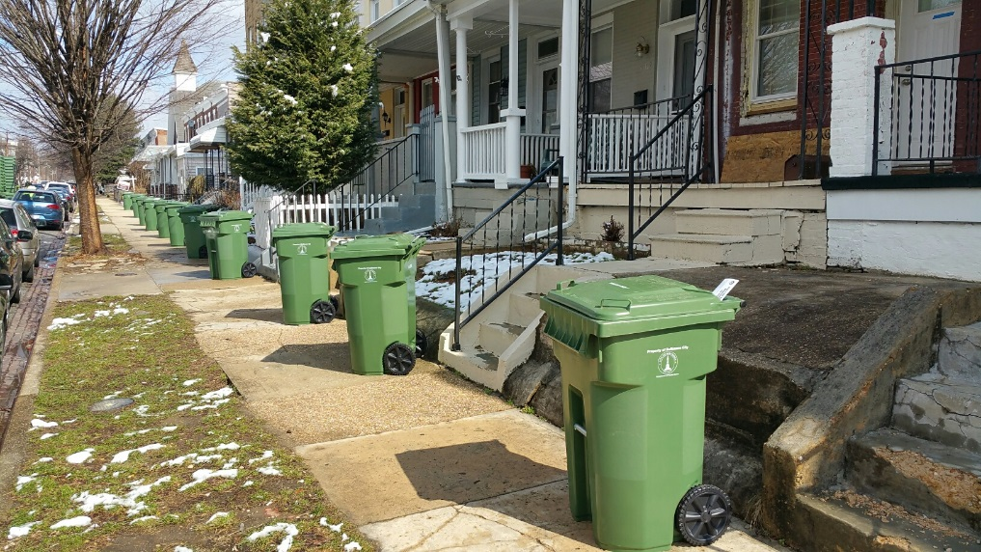
Municipal Trash Cans
The Fiscal 2017 budget will include appropriation to support the Municipal Trash Can Program.
$1.75 million has been budgeted for debt service payments for the new trash cans.
An additional $977k has been budgeted for contributions towards future trash can replacement.
Distribution of the new cans (about 25,000 cans per month) is expected to continue through the end of Summer 2016.
Notes:
Cans cost $8.97M plus $655K interest, financed over five years. Can replacement funding means the city won’t have to borrow money for the program again.

Slide 22
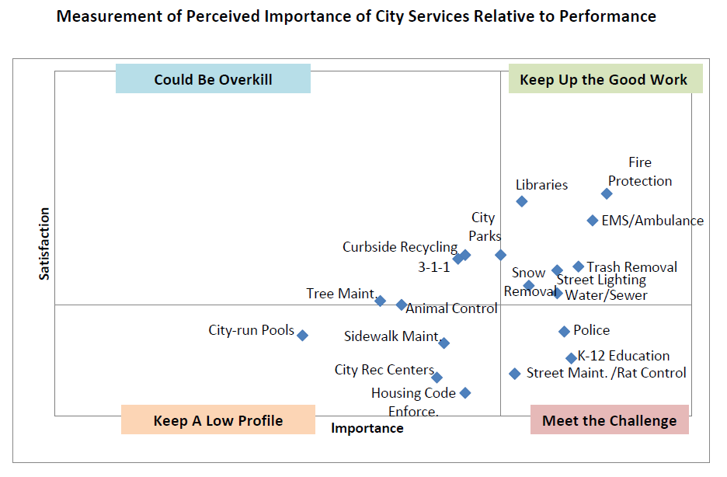
Citizen Survey Results
FY17 budget supports rat abatement and school funding, aligning dollars with citizen preferences and performance enhancement.

Slide 23
FY17 Budget Highlights
Closes $60 million shortfall
Enhances school funding
Continues property tax rate reduction
Makes Circulator finances sustainable
Funds citywide Municipal Can program
Equips police with body cameras
Continues progress on Ten-Year Financial Plan
Maintains or enhances most services
Tough but sensible tradeoffs

Slide 24
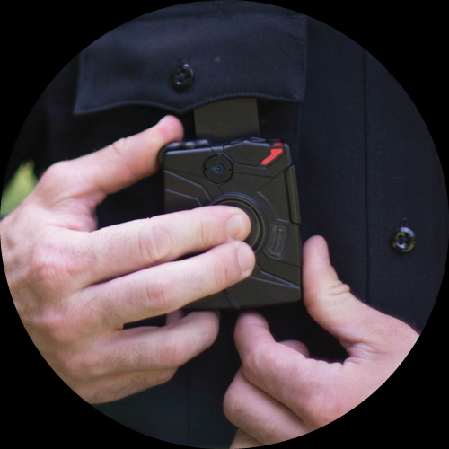
Body-Worn Cameras
The FY17 budget funds the deployment of 1,500 Taser International body worn cameras, as well as the training, software, storage and personnel associated with running the City’s BWC program.
FY17 BPD BWC Budget
Item | FY17 Cost
Personnel (8) | 1,359,475
Contractual | 180,000
OT for Training | 540,000
Taser International Contract | 2,931,210
TOTAL | 5,010,685
FY17 SAO BWC Budget
Item | FY17 Cost
Personnel (18) | 1,405,084
Bandwith | 43,200
Storage/Pro Licenses | 13,980
Data Integration | 75,000
TOTAL | 1,537,264
Notes:
SAO will create a division dedicated to reviewing evidentiary footage and handling caseload associated with the BWC program.

Slide 25
FY17 Budget Highlights
Closes $60 million shortfall
Enhances school funding
Continues property tax rate reduction
Makes Circulator finances sustainable
Funds citywide Municipal Can program
Equips police with body cameras
Continues progress on Ten-Year Financial Plan
Maintains or enhances most services
Tough but sensible tradeoffs
Notes:
Ten year plan initiatives have:
Reduced the city’s long-term baseline costs by over $1 billion
Cut the property tax for homeowners by 7%
Generated $130M in new capital investment
Shrunk unfunded pension and retiree health liabilities by more than 25%
For Fiscal 2017, we have completed another initiative by renewing the voluntary payment agreement with major non-profits for $6M a year, nearly double the average of the six-year agreement that is ending this year.

Slide 26
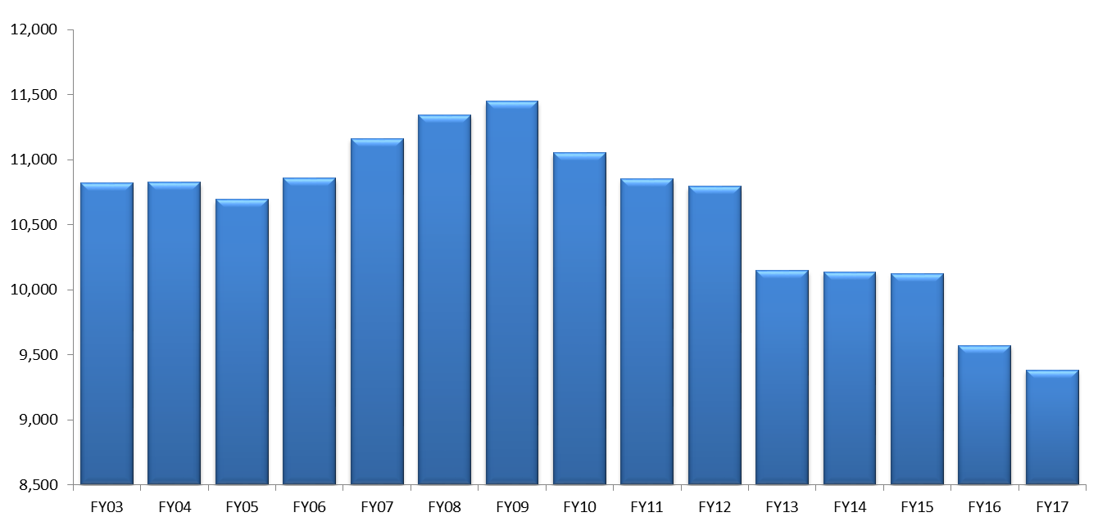
Position Reductions
Number of Funded General Fund Positions
Since the implementation of the Ten-Year Plan, the City has reduced GF positions by 7.5%. The workforce is now the smallest in modern history.
Notes:
Ten year plan goal was -10% by Fiscal 2022.
-150 firefighters
-450 police officers
-19% since Fiscal 2009
More detail about the ten-year plan in the Appendix slides

Slide 27
FY17 Budget Highlights
Closes $60 million shortfall
Enhances school funding
Continues property tax rate reduction
Makes Circulator finances sustainable
Funds citywide Municipal Can program
Equips police with body cameras
Continues progress on Ten-Year Financial Plan
Maintains or enhances most services
Tough but sensible tradeoffs

Slide 28



Priority Outcomes & Indicators
A Safe & Healthy Start
Kindergarten Readiness
Academic Achievement
College & Career Ready
Employment Rate
Number of Jobs
Visitors
Lean Government
Innovation Fund
Shootings
Property Crime
Perception of Safety
Cleanliness of Waterways
Energy Usage
Recycling Rate
Perception of Cleanliness
Blight Elimination
Neighborhood Investment
Sustainable Transportation
Recreation Visits
Heroin-Related Deaths
Mental Health
Childhood Asthma
Notes:
Over the past year, the Administration has been studying the trends, or curves, for each of these indicators and researching best practices for turning those curves in the right direction.
Last September, the Mayor convened more than 200 partners from inside and outside city government to begin developing action plans for each indicator. Those preliminary plans were used to guide the budget process.
The following three slides show trend lines for selected indicators and highlight one or two budget items that we believe will help to turn the curve.
More information about the indicators can be found at outcomestat.baltimorecity.gov. Some of the information is summarized in the Executive Summary budget publication.

Slide 29

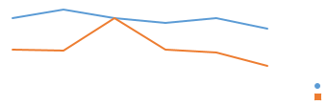

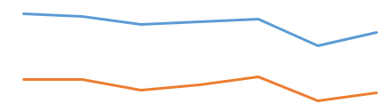
Maintain or Enhance Services
Percent of Third/Eighth graders scoring as “Advanced” and “Proficient” in Reading and Math (MSA transitioning to PARCC assessment)
3rd Grade
8th Grade
Funding City Schools $10.4 million above the Maintenance of Effort (MOE) level, to help make up for lost State formula aid.
Total Number of Shootings
Percent of Residents Who Feel Safe or Very Safe in Their Neighborhood
Maintain funding for proactive crime prevention programs such as Operation Ceasefire, the CitiWatch Crime Camera Program, and Metro Crime Stoppers.
Increase staffing for the Civilian Review Board ($400K)
Notes:
Students scoring advanced or proficient on PARCC test are 8% - 20%
Shootings rose from 371 in 2014 to 636 in 2015
86% report feeling safe during the day, 63% at night (highs were 93% and 68% in 2009)

Slide 30


Maintain or Enhance Services
Number of Vacant Residential Properties
Continue $10 million in City funding for demolition and relocation.
Leverage $19 million in new State funding.
City Resident Employment Rate
Support current levels of service for Employment Enhancement Services, such as career one-stop centers and community job hubs, and double Bridge 2 Career funding.
Notes:
16,870 residential buildings deemed uninhabitable, about the same as 2010
Employment rate for 16 to 64 year olds was 62.1% in 2014, up from 50% in 2012.

Slide 31



Maintain or Enhance Services
Percent of Citizens Rating the Cleanliness of their Neighborhood as ‘Good’ or ‘Excellent’
Upgrade HCD surveillance cameras for enforcement of illegal dumping ($80K).
Total Heroin-Related Deaths
Percent of Citizens who Reported More than 8 Days in the Past Month in Which Mental Health was Not Good
Support for move toward Community Paramedicine in EMS, diverting non-emergency clients to the most appropriate health facilities ($398K).
Establish a 24/7 stabilization center providing sobering services and linkage to care, addressing over-utilization of ER ($205K).
Notes:
Percent rating city’s cleanliness good or excellent was 49% in 2015, compared to a high of 61% in 2011
192 heroin-related deaths in 2014, sup from 76 in 2011
Percent of citizens reporting poor mental health was 17.3% in 2013

Slide 32
FY17 Budget Highlights
Closes $60 million shortfall
Enhances school funding
Continues property tax rate reduction
Makes Circulator finances sustainable
Funds citywide Municipal Can program
Equips police with body cameras
Continues progress on Ten-Year Financial Plan
Maintains or enhances most services
Tough but sensible tradeoffs

Slide 33
Tough Choices in the Fiscal 2017 Budget
Revenue
New voluntary payment agreement with the City’s major tax-exempt non-profit organizations ($6M)
Increasing the Parking Tax from 20% to 24% to fund the Charm City Circulator, including fleet replacement ($6M)
Increasing EMS fees ($4M)
Spending
Reducing 225 vacant police officer positions ($20M)
Pay freezes for police officers, firefighters, and sheriff deputies ($6.5M)
Pay crossing guards for hours worked ($1.5M)
Reduce paygo capital ($1.5M)
Closure of the Eastern Community Action Center ($0.7M)
Eliminate funding for earmarked grants ($0.6M)
Closure of Northwood and Waverly before and after care centers ($0.2M)
Notes:
Brings EMS fees in line with other large jurisdictions. Insurance companies pay the fee.
Pay crossing guards for 2 hours a day instead of 4. City Schools can pay them for doing additional work inside the school. The City is negotiating this change with CUB.
State CSBG funding reduction impacts CACs
Earmarked grants for TFA, Experience Corps and Maryland Extension total about $450K. They should compete for limited funding along with the many other non-profits that do good work in the city. Competition requires demonstrating results.
Before and After Care:
The Administration would like to continue transitioning city government out of the child care business
The State provides portable vouchers and there are many private and non-profit providers
We won’t leave any families without child care
The plan is to reinvest savings in the City Schools

Slide 34
Fiscal Risks
Labor Negotiations
Teacher Pension
Termination Leave Payment
Trial preparation
Department of Justice Review
Pension Litigation
Economy
Notes:
SAFER Grant
Safe Streets State funding
DOJ Review: BWC and BPD positions

Slide 35
Appendix

Slide 36
Local Impact Aid
The Fiscal 2017 budget includes $11.35 million to support projects in the Horseshoe Casino Area.
$8.025 million in the operating budget and $3.325 million in capital projects.
Spending plan was developed with community through Local Development Council.
Projects Include:
Workforce Training & Employment Connection Center: $1.05 million
Educational partnerships & food access initiatives: $565k
Increased public safety & sanitation services in casino area: $2.92 million
Benefit District Support: $925k
Notes:
Details on page 314 of Volume II of Agency Detail

Slide 37
State & Federal Funding
Federal Funding Recommended at $168.4 Million:
  The Fiscal 2017 budget is flat for formula grants awarded through Housing and Urban Development.
    CDBG allocation is $19.8 million, consistent with the Fiscal 2016 appropriation.
  $19.9 million for Homeless Services through HUD funding.
    $14.7 million will be devoted to permanent housing efforts.
  $6.8 million new funding for HIV Case Management through CDC.
State Funding Recommended at $100 Million:
  Includes $3.0 million to support Charm City Circulator operations.
  Includes next installment of the 2-year, $5 million Empower MD grant for weatherization assistance programs.
Notes:
HUD temporary housing grant

Slide 38
Utility Funds
The Stormwater rates from property owners will remain consistent with Fiscal 2016 levels, DPW will announce Water/Wastewater rates for Fiscal 2017 at a later date.
Major Highlights:
  Upgrades to the City’s Water meter and billing systems are expected to be completed by October 2016 for Baltimore City consumers and July 2017 for Baltimore County consumers.
  Implementation of the Pre-Stressed Concrete Cylinder Pipe (PCCP) comprehensive inspection and monitoring program to proactively predict pipeline damage and failures and take appropriate actions to repair or renew.
  Continued implementation of the Sewer Lateral Inspection and Renewal Program which resulted in an over 250% increase in the number of repair locations scheduled in Q4 FY2015.
Key Performance Targets:
  232 million gallons of water will be treated daily.
  The Department of Public Works will rehab or replace 79,800 linear feet of the water distribution system.
  1.0% of meters will be estimated annually, a decrease of 0.3% from 2015; billing accuracy should improve due to fewer estimates.

Slide 39
Ten Year Financial Plan Update

Slide 40
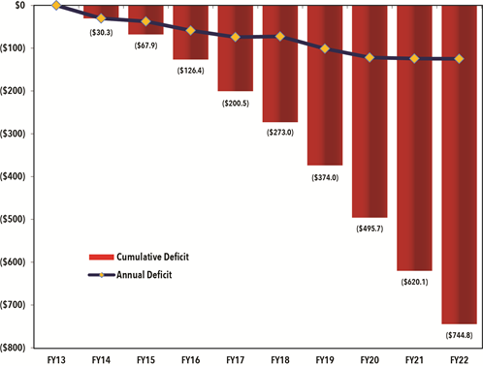
Original 10 Year Plan Projection

Slide 41
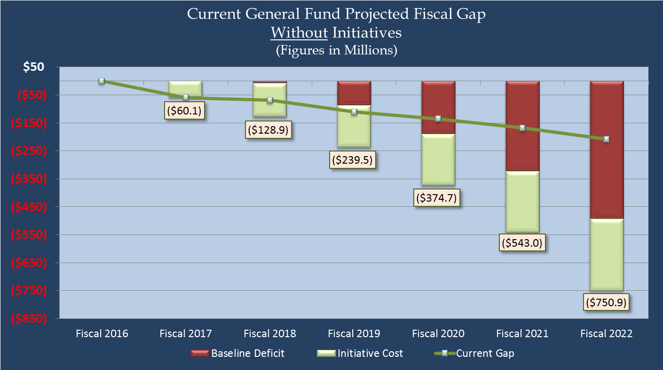
10 Year Plan:
34% Reduction in Cumulative Gap
The baseline deficit of $491M represents a 34% reduction from the original cumulative gap of $745M.

Slide 42
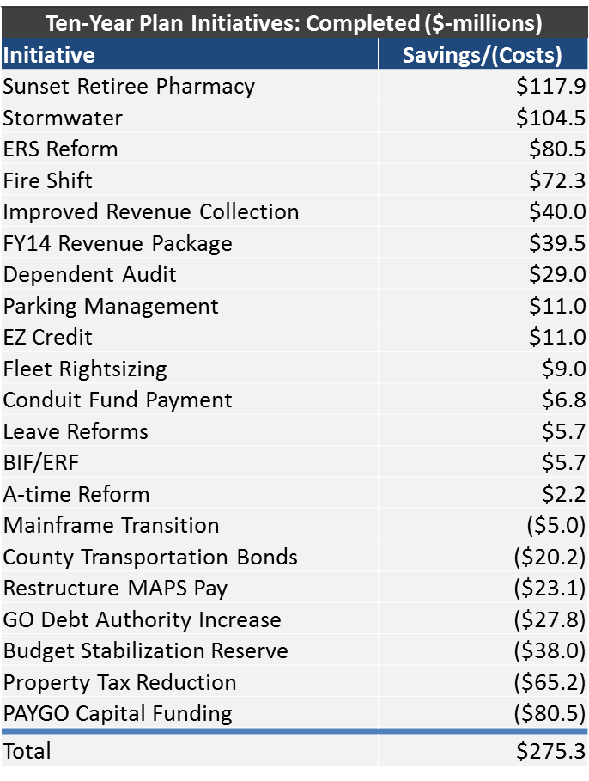
10 Year Plan:
Initiatives Completed
$535M
(savings)
-$260M
(costs)

Slide 43
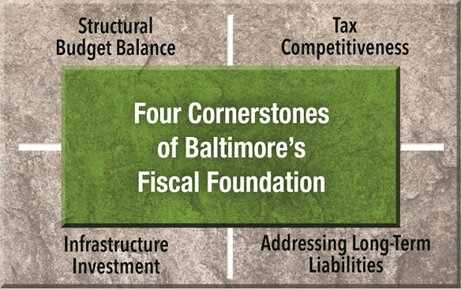
Future Initiatives
Structural Budget Balance: A hybrid pension system for new sworn fire and police employees, continued workforce streamlining, VOIP to reduce telephone costs, fleet rightsizing, further changes to health benefit plans.
Tax Competitiveness: Establishment of a solid waste enterprise and property tax reduction beyond 2020.
Infrastructure Investment: Continuation of PAYGO capital funding above baseline, increased GO Bond issues, extension of county transportation bond borrowing. Sale of parking garages proposed to fund recreation centers.
Addressing Long-Term Liabilities: Meet budget stabilization reserve target, share retiree health benefit costs with BCPS, promote wellness, continue to rebalance employee compensation.

Slide 44
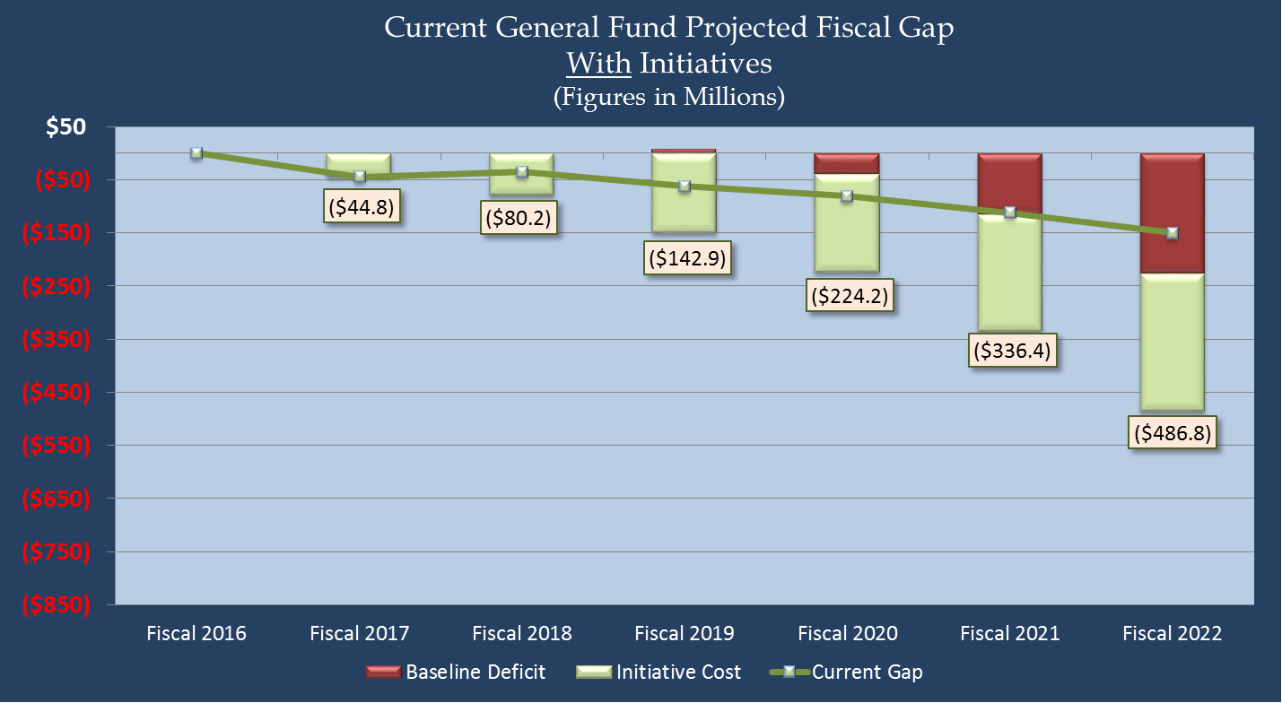
10 Year Plan:
Potential for Further Deficit Reductions
Implementing the remaining initiatives could reduce the baseline deficit to $227M. This is a 70% reduction to the original $745M gap.

Slide 45
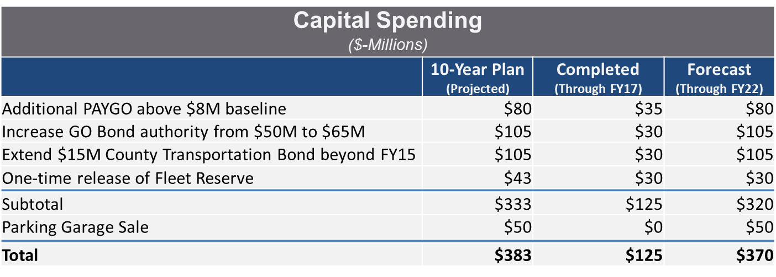
Capital Funding

Slide 46
Revenue Outlook

Slide 47
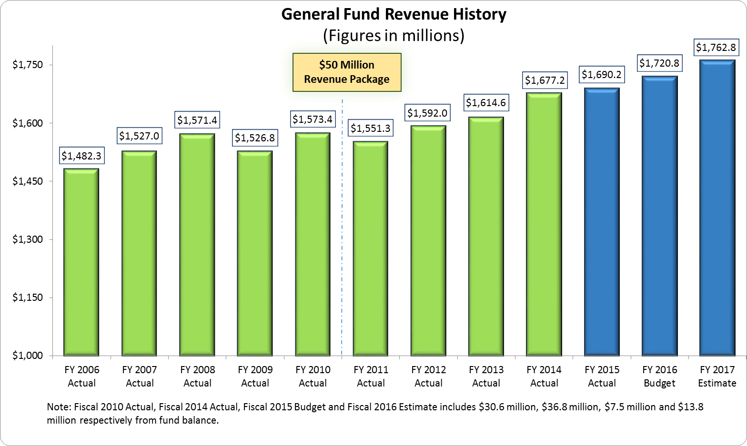
Revenue:
Shows Economic Recovery

Slide 48
Revenue:
General Fund Revenue Growth
 | Fiscal 2015 Actual | Fiscal 2016 Budget | Fiscal 2017 Estimated | Dollar Change | Percent Change
Revenue Category
Property Taxes | $811,589,266 | $857,184,430 | $873,090,348 | $15,905,918 | 1.9
Income Taxes | 307,764,022 | 293,109,000 | 317,656,198 | 24,547,198 | 8.4
Highway User Revenues | 133,685,316 | 137,796,122 | 142,300,081 | 4,503,959 | 3.3
State Aid | 103,697,746 | 102,824,797 | 103,302,831 | 478,034 | 0.5
Energy Tax | 41,711,107 | 41,689,000 | 42,259,000 | 570,000 | 1.4
Net Parking Revenue | 37,740,911 | 37,590,861 | 39,525,585 | 1,934,724 | 5.1
Telecommunication Tax | 33,637,912 | 34,021,000 | 34,070,000 | 49,000 | 0.1
Recordation & Transfer Tax | 70,912,654 | 57,553,000 | 64,550,321 | 6,997,321 | 12.2
Hotel Tax | 26,698,367 | 27,451,063 | 28,419,912 | 968,849 | 3.5
Speed Cameras | 325,458 | 2,500,000 | 0 | (2,500,000) | (100.0)
Investment Earnings | 810,886 | 1,426,000 | 3,633,000 | 2,207,000 | 154.8
All Other | 121,670,796 | 127,707,974 | 113,974,176 | (13,733,798) | (10.8)
Total General Fund Revenue | $1,690,244,442 | $1,720,853,247 | $1,762,781,452 | 41,928,205 | 2.4
$42M of growth over Fiscal 2016

Slide 49
Revenue:
Continued Property Tax Growth Expected
Real and Personal Property Tax Revenues
(Dollars in Millions)
14% growth since Fiscal 2013.

Slide 50
Revenue:
Property Value Growth
3 years of assessment increases after four years of decline.

Slide 51
20 Cents by 2020 – On Track

Slide 52
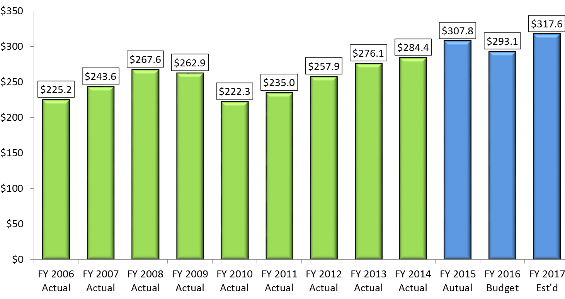
Income Tax Recovery
Income Tax
(Figures in Millions)

Slide 53
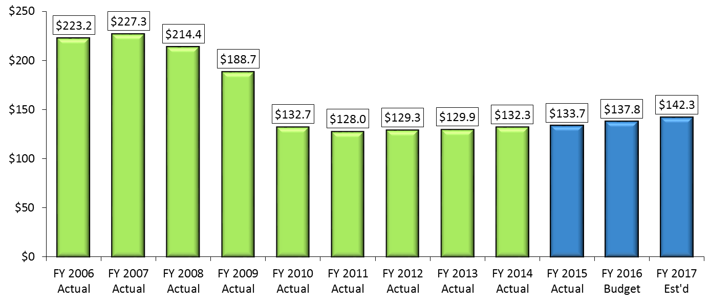
Highway User Revenues
Highway User Revenues
(Figures in Millions)

Slide 54
Fixed Costs

Slide 55
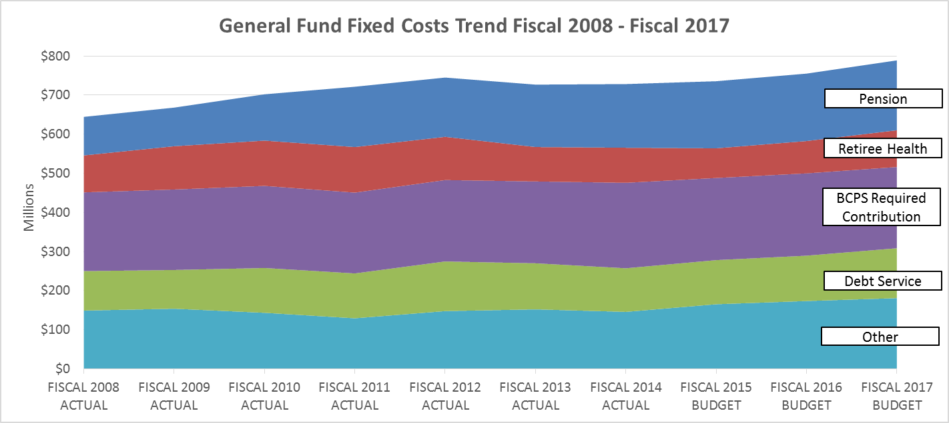
Fixed Costs by Category
Fixed costs increased by 15.6% between FY08 & FY12, and 3.9% between FY13 & FY16

Slide 56
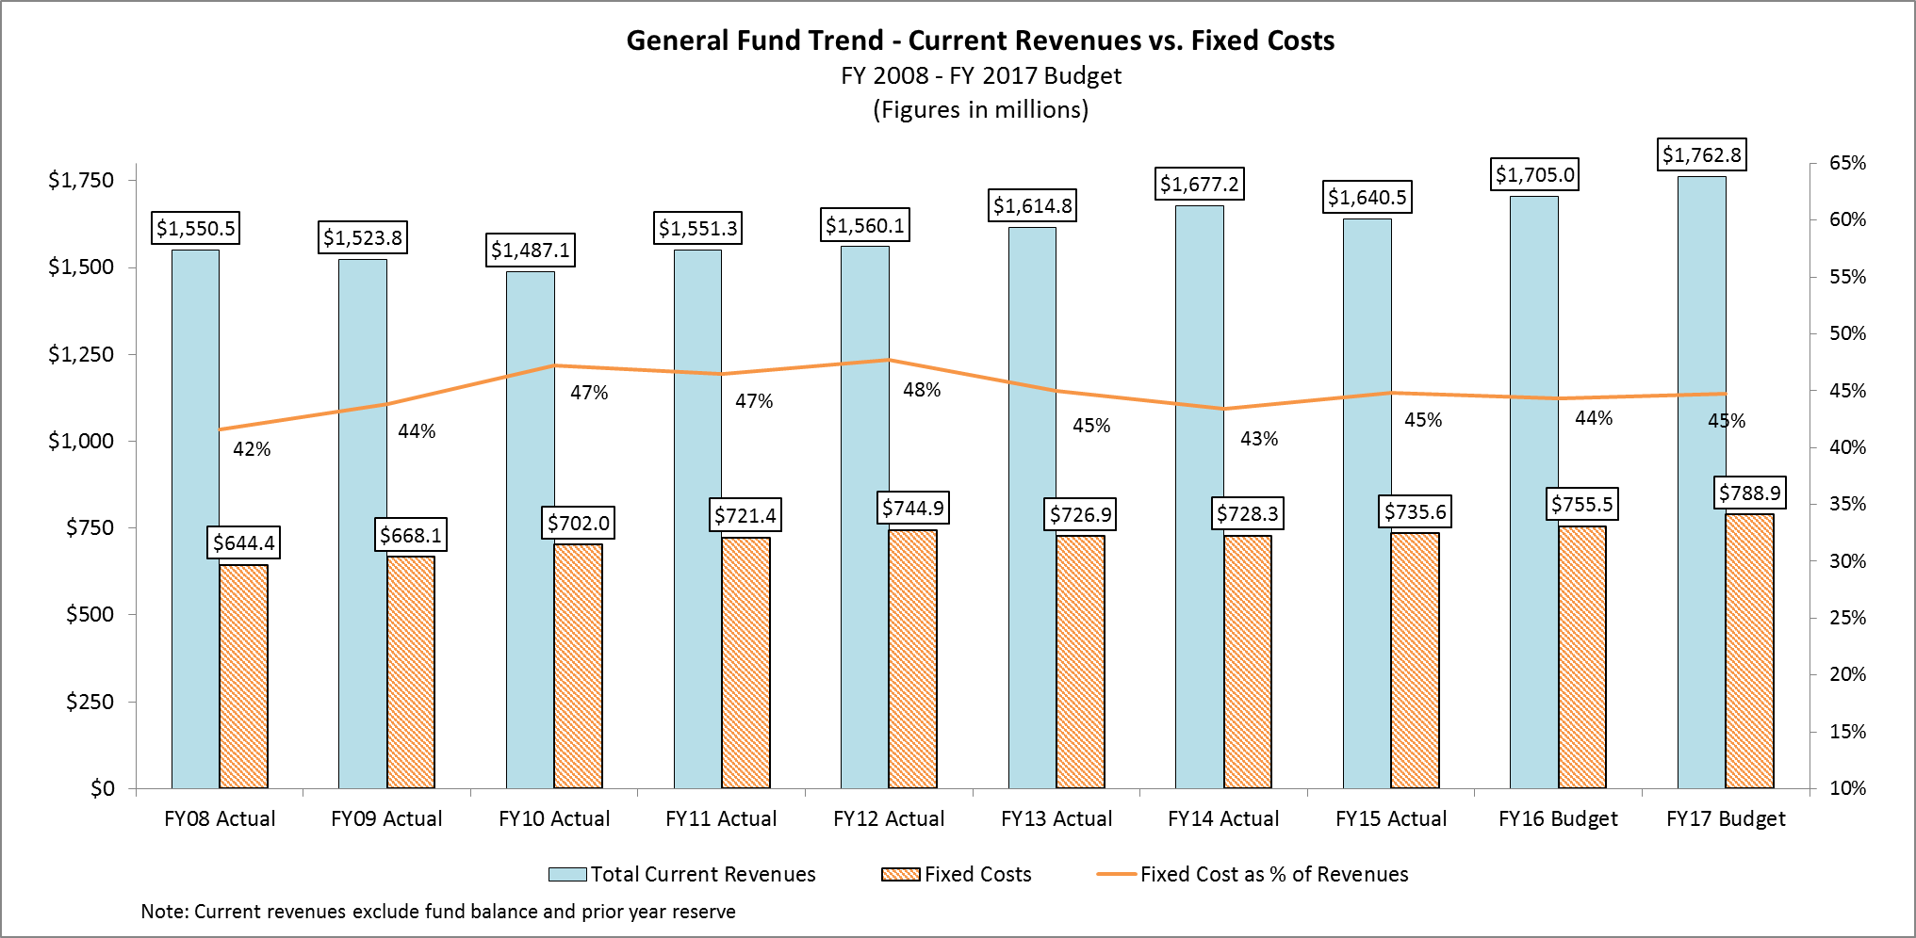
Reforms Reduce Fixed Costs

Slide 57
ERS Contribution

Slide 58
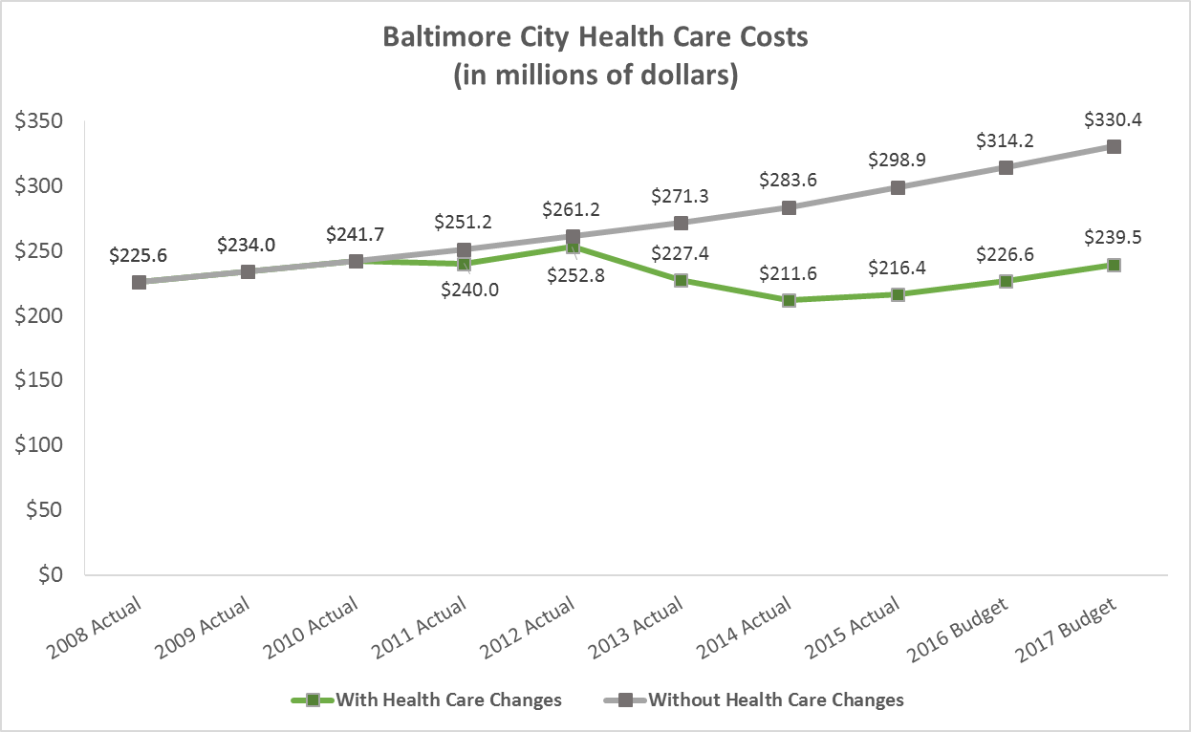
Health Benefit Reform Savings

Slide 59
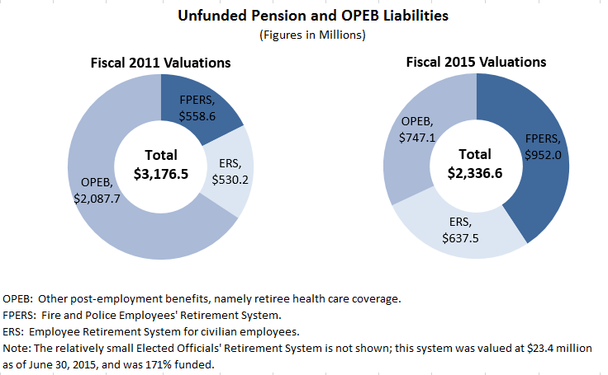
Unfunded Liabilities
Unfunded Pension and OPEB liabilities have shrunk by $840 million (26%).
Notes:
Pension liabilities continue to grow:
Plans have generally underperformed investment return assumptions.
Plans are both using closed amortization, which pays down the unfunded liability on a fixed schedule, and means that investment losses must be amortized over a shorter and shorter timeframe.
They now use entry age normal actuarial cost method, which level funds pension contributions throughout the working career of employees. The previous Projected Unit Cost method backloaded these contributions.
New accounting rules for valuing assets have also increased liability calculation.
ERS liability spiked in Fiscal 2012 valuation and has shrunk since then.

Slide 60
Recommended Budget Plan

Slide 61
Fiscal 2017 Operating Budget

Slide 62
Fiscal 2017 Capital Budget
Total Capital Budget:
$524.5 Million

Slide 63
FY17 Capital Budget Highlights
$15.5M General Fund PAYGO supports:
  $1.1 million for Department of Recreation & Parks projects
  $8.7 million for Transportation initiatives
  $1.2 million for BHIP home buying incentives
  $1.8 million to replace 311 system
  $65M GO Bond Funding supports:
    $17 million for renovation of City schools
    $25 million for community & economic development
    $6.3 million for park and recreation facility improvements
    $15M in County Transportation bonds for street and bridge repairs
    $228M in Federal and State grants - $150 million increase over FY16
    $154M in utility and other funds supports:
      $27 million of water, waste water, stormwater projects
      $35 million for Conduit construction and maintenance
Notes:
More information about the Capital Budget starts on page 149 of the Executive Summary. Planning has published the full capital budget.

Slide 64
Priority Outcomes & Indicators
A Safe & Healthy Start
Kindergarten Readiness
Academic Achievement
College & Career Ready
Employment Rate
Number of Jobs
Visitors
Lean Government
Innovation Fund
Shootings
Property Crime
Perception of Safety
Cleanliness of Waterways
Energy Usage
Recycling Rate
Perception of Cleanliness
Blight Elimination
Neighborhood Investment
Sustainable Transportation
Recreation Visits
Heroin-Related Deaths
Mental Health
Childhood Asthma

Slide 65



Better Schools
Number of deaths of children less than one year of age per 1,000 live births
Percent of Children Ready to Enter Kindergarten (MMSR transitioning to R4K assessment)
Percent of Third/Eighth graders scoring as “Advanced” and “Proficient” in Reading and Math (MSA transitioning to PARCC assessment)
Baltimore City Public Schools 4-year Adjusted Cohort Graduation Rate
3rd Grade
8th Grade
BCPS graduation rate has increased since 2010.
New assessments used to measure academic achievement are establishing a new baseline.
Infant mortality rate has grown since 2012.

Slide 66
Better Schools
Increase funding for City Schools by $10.4 million over the Maintenance of Effort (MOE) level, to help make up for lost State formula aid.
Maintain base funding of $6.2 million for Family League after-school programming.
The one-time Fiscal 2016 supplement of $4.2 million for Family and Associated Black Charities is not sustained.
Funding for earmarked Family League grants to Teach for America, Cooperative Extension, and Experience Corps is discontinued.
Partially restore B’More for Healthy Babies/Health Care Access Maryland positions cut by the State ($225K).
New technology for mobile offsite registration of YouthWorks participants ($13K).

Slide 67

Safer Streets
Total Number of Shootings
Property Crime Rate per 100,000 People
Percent of Residents Who Fell Safe or Very Safe in Their Neighborhood
Perception of safety is beginning to trend back in the right direction.
Spikes in both shootings and property crime during 2015.

Slide 68
Safer Streets
Salary Save 225 vacant Police Officer positions - $20M in savings. BPD will implement operational efficiencies to move officers from behind desks to patrol, end manual timekeeping and improve technology.
Maintain funding for proactive crime prevention programs such as Operation Ceasefire, the CitiWatch Crime Camera Program, and Metro Crime Stoppers.
Maintain police special operations units.
Increased staffing for the Civilian Review Board.
Maintain funding for preventative street-light maintenance and the continuation of LED installation in high-crime neighborhoods.
Maintain fire companies.
Renegotiation of Crossing Guard pay policy to reflect actual hours worked.
Purchase licenses to Online Learning Management System for Fire personnel to complete training at the fire house ($100K).
Sixteen Crime Lab positions to reduce backlog and improve quality ($1.8M).
New analytical/storage software for CitiWatch to improve data use ($150K).

Slide 69
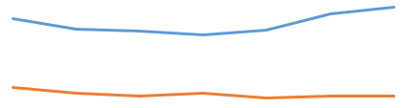


Stronger Neighborhoods
Number of Vacant Residential Properties
Number of Permits Issued for Construction or Rehabilitation Worth More Than $5,000
Percent of Residents Using Sustainable Transportation to Get to Work, School, or Shopping
Total Number of Visits to City-Operated Recreation Facilities
Number of permits, especially residential, has been increasing.
Use of sustainable transportation, especially walking and biking, is increasing.

Slide 70
Stronger Neighborhoods
Use table games aid to fund operations for new and expanded recreation centers.
Continue free summer camps.
Support current levels of vacant property cleaning and boarding, including support for Mayor’s Crime and Grime initiative.
Continue $10 million in City funding for demolition and relocation.
Fully fund Circulator service and bus replacement through increase in parking tax from 20% to 24%.
Reduction in one-time funding provided to Community Action Centers in FY16 due to loss of approximately $668K of State CSBG funding.
Direct Mailing Dataset will allow quick identification of vacant buildings and improve billing and mailing efforts across agencies ($21K).
Upgrade Park Maintenance positions to higher skill levels ($80K).

Slide 71


Growing Economy
City Resident Employment Rate
Total Number of Jobs in The City of Baltimore
Total Number of Visitors to Baltimore
Employment rate measures percent of residents age 16-64 who are employed, and has been level over the past couple years.
Total number of jobs has been steadily increasing since 2011.

Slide 72
Growing Economy
Support current levels of service for Employment Enhancement Services, such as career one-stop centers and community job hubs, and double Bridge 2 Career.
Strengthen small business through the Emerging Technology Center, Small Business Resource Center, Main Streets, and MWBOO.
Maintain funding for Special Event Support and Inner Harbor services in DOT.
Maintain current levels of service for the Office of Civil Rights and Wage Enforcement.
Charge appropriate BDC overhead costs to Capital projects.
Adjusted benefit reimbursements for art museums in line with actual costs.

Slide 73
Innovative Government
Maintain funding for current IG investigations and hire new investigator focusing on Fire and Police disability and worker’s compensation fraud.
Maintain funding for preventative maintenance of fleet and facilities.
Maintain funding for a data warehouse and the City’s Open Data website.
Establish a capital reserve for public buildings in the Internal Service Fund.
Create six Human Resources positions to support the civil service hiring process.
Reduction in funding for the annual Citizen Survey, requiring external revenue sources for support and moving to a biennial survey.
Create claims review process and investigate tort claims against Police, generating savings and more quickly identifying problem Officers ($100K).
Upgrade Law Department technology enabling City-wide data collection ($570K).
New accountants to support quadrennial audits and grant compliance ($500K).

Slide 74

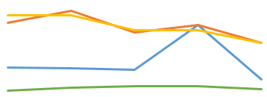



A Cleaner City
City of Baltimore Recycling Rate
Percent of Citizens Rating the Cleanliness of their Neighborhood as ‘Good’ or ‘Excellent’
Average Geometric Mean for E.coli in Baltimore City Watersheds
Citywide Gas/Electric Energy Usage
Gas
Electric
Decrease in Recycling Rate is related to change in eligible materials under Maryland Recycling Act.
Increase in Citizen Perception of Cleanliness in 2015.

Slide 75
A Cleaner City
Municipal Can Program will distribute a standard 65-gallon trash can to each City residence. Includes budget for debt service and can replacement.
Increase funding for the Environmental Control Board to support contractual hearing officers based on an increase in number of environmental citations.
Maintain current services for trash and recycling collection, street and alley cleaning, graffiti removal and other sanitation services.
A one-time $1.0 million transfer from the Stormwater Fund will support Mechanical Street Sweeping during Fiscal 2017.
Fund an Emerald Ash Borer Response Plan and increase Proactive Pruning cycle from nine neighborhoods per year to 15 ($575K).
Upgrade HCD surveillance cameras for enforcement of illegal dumping ($80K).

Slide 76

A Healthier City
Total Heroin-Related Deaths
Number of Childhood Asthma ER Visits per 100,000 People
Percent of Citizens who Reported More than 8 Days in the Past Month in Which Mental Health was Not Good
Heroin-related deaths have continued to increase since 2011.
Asthma ER visits have come down since 2012, but increased in the past year.

Slide 77
A Healthier City
Increase funding for Temporary Housing for the Homeless to support the current demand for sheltering services.
Reduce unused Summer Food Program meals, cutting the City’s costs.
Increase the EMS fees for basic and advanced life support transport, mileage, and EKGs to bring them in line with other large municipalities.
Support for move toward Community Paramedicine in EMS, diverting non-emergency clients to the most appropriate health facilities ($398K).
Establish a 24/7 stabilization center providing sobering services and linkage to care, addressing over-utilization of ER ($205K).
Upgrade Health clinical infrastructure, including new electronic health record and lab management system enabling clinics to bill insurers for services ($200K).

Slide 78
Fiscal Risks
Labor Negotiations
Teacher Pension
Termination Leave Payment
Trial preparation
Department of Justice Review
Pension Litigation
Economy
Notes:
SAFER Grant
Safe Streets State funding
DOJ Review: BWC and BPD positions

